Slide 1

Predictive Analytics in Business (BUAN 448)
Cluster Analysis part 2
(Chapter 15)
BUAN 488 – Fall 2022 – Dr. Davoodi

Slide 2
Clustering: The Main Idea
Review
Goal: Form groups (clusters) of similar records
Used for segmenting markets into groups of similar customers

Slide 3
Example: Public Utilities
Review
Goal: find clusters of similar utilities
Data: 22 firms, 8 variables
Fixed-charge covering ratio
Rate of return on capital
Cost per kilowatt capacity
Annual load factor
Growth in peak demand
Sales
% nuclear
Fuel costs per kwh

Slide 4
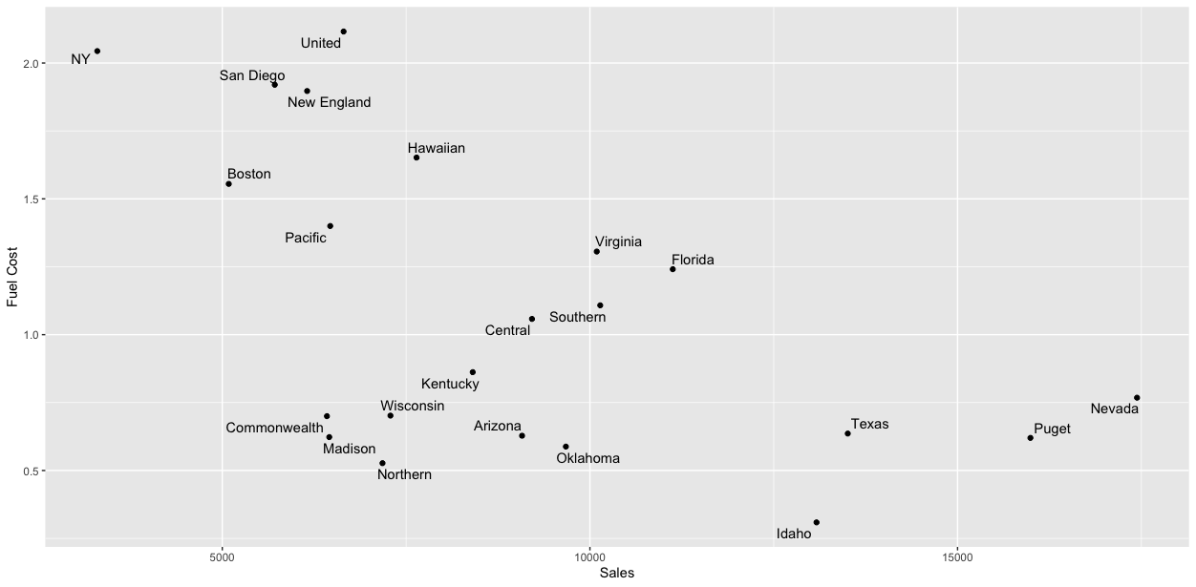
Example: Public Utilities
Review
High fuel cost, Low sales
Low fuel cost, relatively Low sales
Low fuel cost, High sales
Clustering just based on the two measurements

Slide 5
Extension to More Than 2 Dimensions
Review
In prior example, clustering was done by eye
Multiple dimensions require formal algorithm with
A distance measure
A way to use the distance measure in forming clusters
We will consider two algorithms: hierarchical and non-hierarchical

Slide 6
The Hierarchical Clustering Steps (Using Agglomerative Method)
Review
Start with n clusters (each record is its own cluster)
Merge two closest records into one cluster
At each successive step, the two clusters closest to each other are merged
Dendrogram, from bottom up, illustrates the process

Slide 7
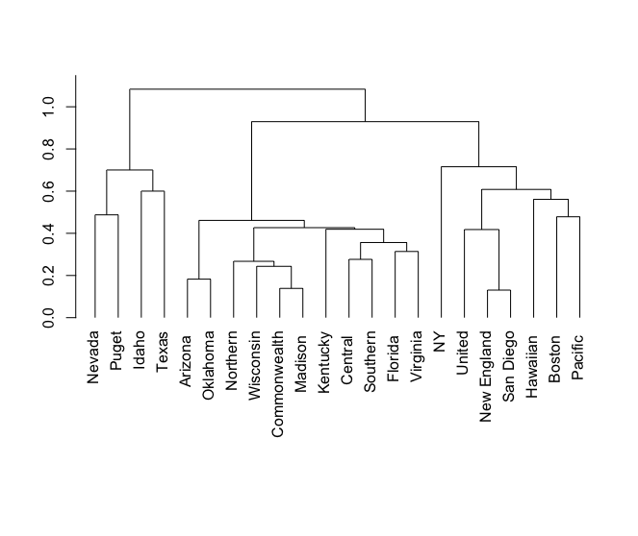
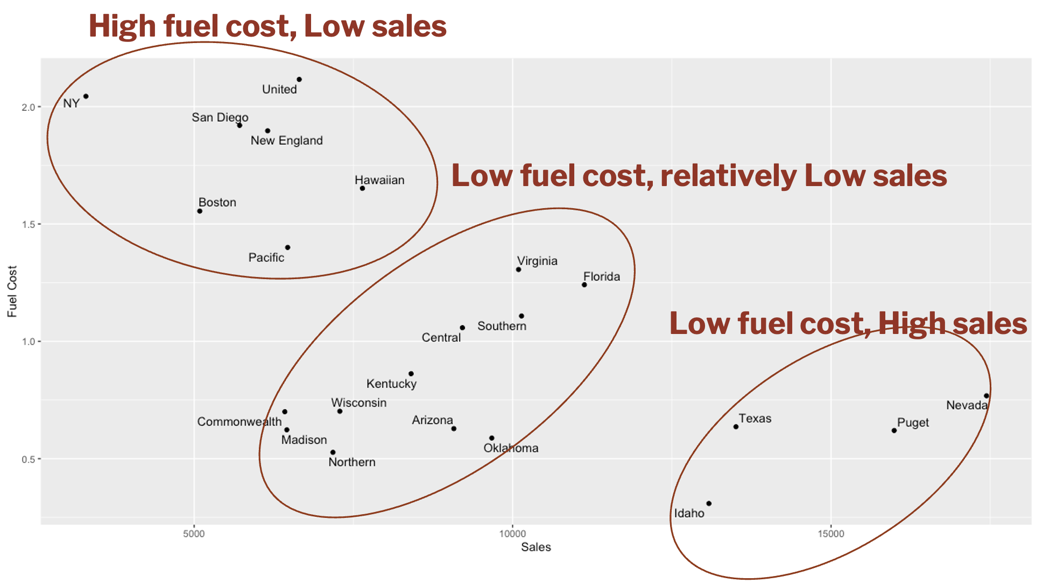
Review
Dendrogram for Single Linkage
Clustering just based on the two measurements

Slide 8
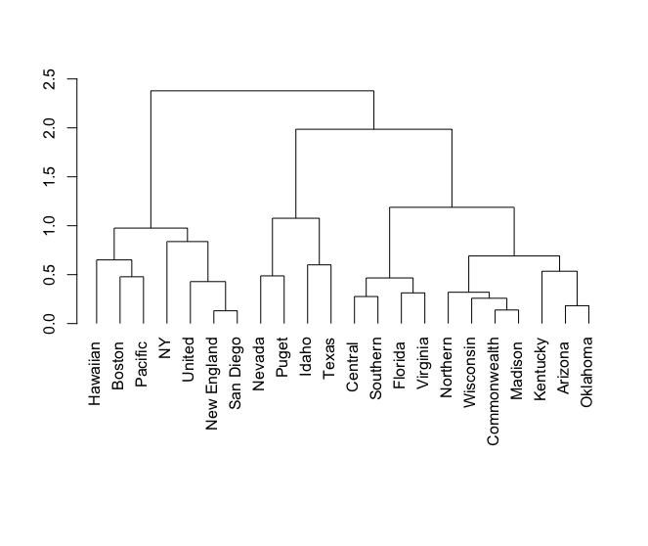
Review
Dendrogram for Average Linkage
Clustering just based on the two measurements

Slide 9
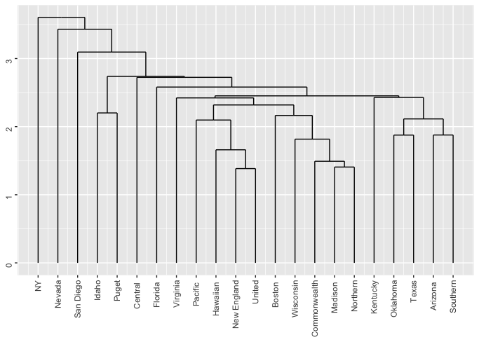
Dendrogram for Single Linkage
If clusters must be at least 3 units apart, then you have 4 clusters
1
1
1
19
Clustering based on the Eight measurements

Slide 10
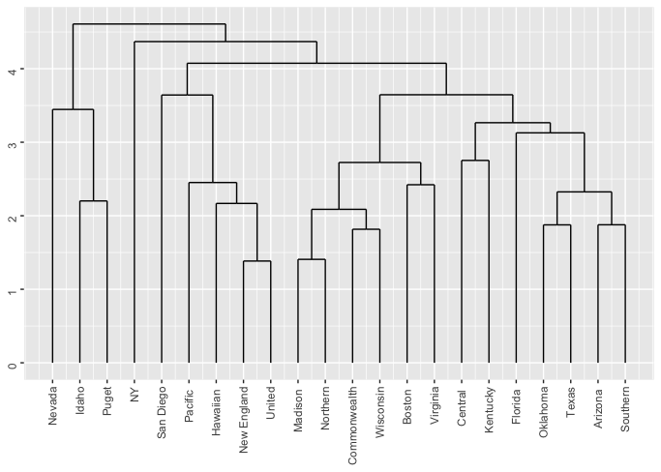
Dendrogram for Average Linkage
At 4 units of distance, there are 4 clusters
3
1
5
13
Clustering based on the Eight measurements

Slide 11
Ward Distance
Ward’s method considers the “loss of information”
Consider the values (2,6,5,6,2,2,2,2,0,0,0) with a mean of 2.5
“error sum of squares” (ESS)
(2−2.5)² +(6−2.5)² +(5−2.5)² +...+(0−2.5)² = 50.5.
Single Group ESS = 50.5

Slide 12
Ward Distance
Four groups: mean of each group is equal to its member value
(0, 0, 0), (2, 2, 2, 2), (5), (6, 6)
(0−0)² + … + (2−2)² + … + (5−5)² +...+(6−6)² + …= 0
The loss of information is the sum of the ESS’s for each group, which is 0
Ward’s method tends to result in convex clusters that are of roughly equal size

Slide 13
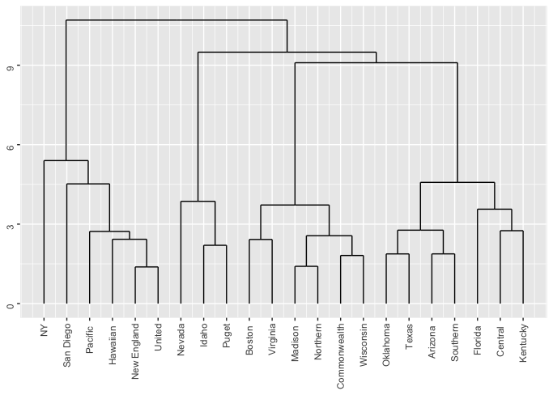
Dendrogram for Ward Linkage
At 6 units of distance, there are 4 clusters
6
3
6
7
Clustering based on the Eight measurements

Slide 14
Validating Clusters

Slide 15
Heatmap
A heatmap is another way to visualize hierarchical clustering.
It’s also called a false colored image, where data values are transformed to color scale.
Simultaneously visualize clusters of samples and features.
It can help to find the variables that appear to be characteristic for each sample cluster.

Slide 16
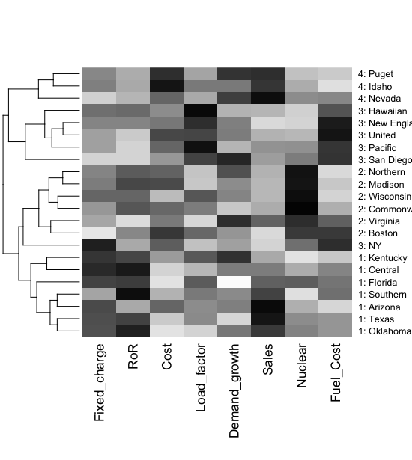
Visualize Cluster Features with Heatmap
(darker = higher values)
Considering 4 clusters,
The bottom cluster has higher Fixed_charge and RoR than the other three
The second cluster has higher Nuclear and
The third cluster has higher Fuel_cost and Load_factor
The fourth cluster has higher Demand_growth and Cost

Slide 17
Desirable Cluster Features
Stability – are clusters and cluster assignments sensitive to slight changes in inputs? Are cluster assignments in partition B similar to partition A?
Separation – check ratio of between-cluster variation to within-cluster variation (higher is better)

Slide 18
Limitations of Hierarchical Clustering
Hierarchical clustering requires high-dimensional computations
Low stability index
Reordering data or dropping a few records can lead to a different solution.
Sensitive to relative distance metrics (Normalization method may affect the output)
Hierarchical clustering is sensitive to outliers.

Slide 19
Nonhierarchical Clustering: K-Means Clustering

Slide 20
The k-means problem
Given a set X of n points in a d-dimensional space and an integer k
Task: choose a set of k points {c₁, c₂,…,c_{k}} in the d-dimensional space to form clusters {C₁, C₂,…,C_{k}} such that
is minimized
Some special cases: k = 1, k = n

Slide 21
K-Means Clustering Algorithm
Choose # of clusters desired, k
Start with a partition into k clusters
Often based on random selection of k centroids
At each step, move each record to cluster with closest centroid
Recompute centroids, repeat step 3
Stop when moving records increases within-cluster dispersion

Slide 22
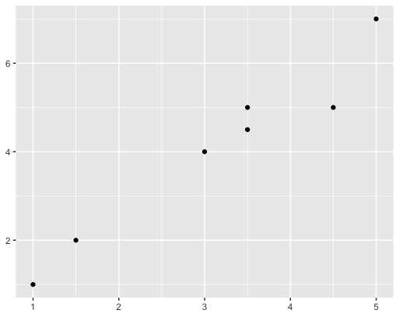
K-Means Clustering Algorithm
Choose # of clusters desired, k=2
Start with a partition into 2 clusters
Often based on random selection of 2 centroids

Slide 23
K-Means Clustering Algorithm
At each step, move each record to cluster with closest centroid
Recompute centroids, repeat step 3
Stop when moving records increases within-cluster dispersion

Slide 24
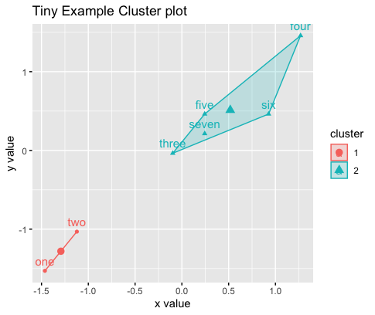
K-Means Clustering Algorithm
The previous example using kmeans algorithm

Slide 25
K-means Algorithm: Choosing k and Initial Partitioning
Choose k based on the how results will be used
e.g., “How many market segments do we want?”
Also experiment with slightly different k’s
Initial partition into clusters can be random, or based on domain knowledge
If random partition, repeat the process with different random partitions

Slide 26
K-means Algorithm: Utility Firms
It needs preprocessing like the hierarchical algorithm
The number of clusters should be specified at the beginning

Slide 27
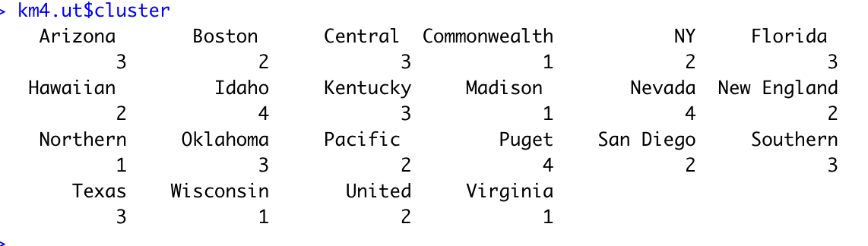
Code for K-means Clustering
(data prep as for hierarchical)
ask for 4 clusters
Km4.ut <- kmeans(utilities.df.norm, 4)
# show cluster membership
Km4.ut$cluster

Slide 28
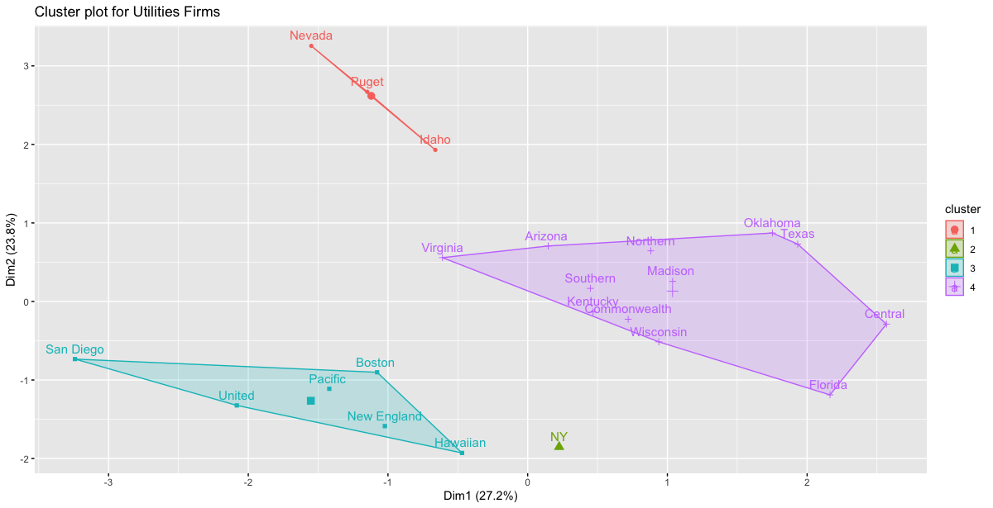
Utility Firms Plot, 4 Clusters

Slide 29
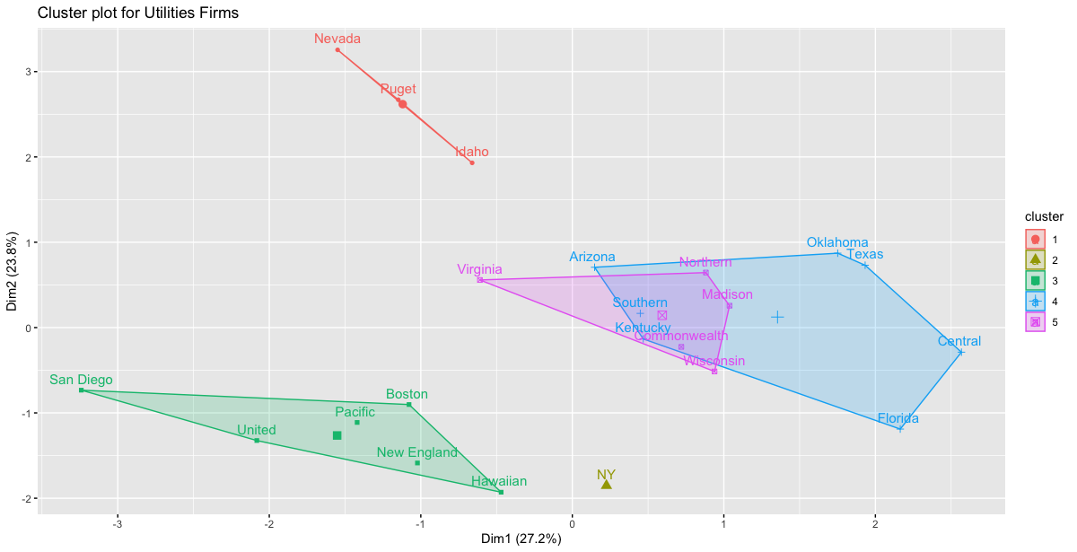
Utility Firms Plot, 5 Clusters

Slide 30
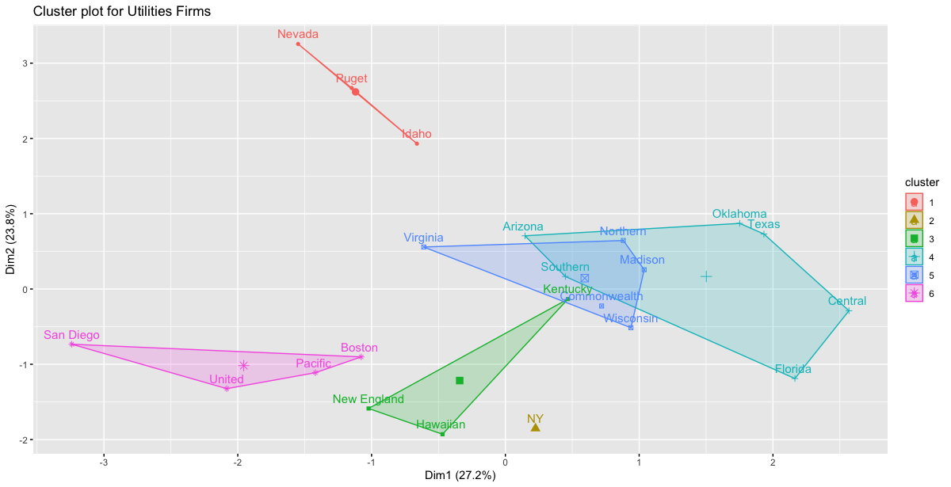
Utility Firms Plot, 6 Clusters

Slide 31
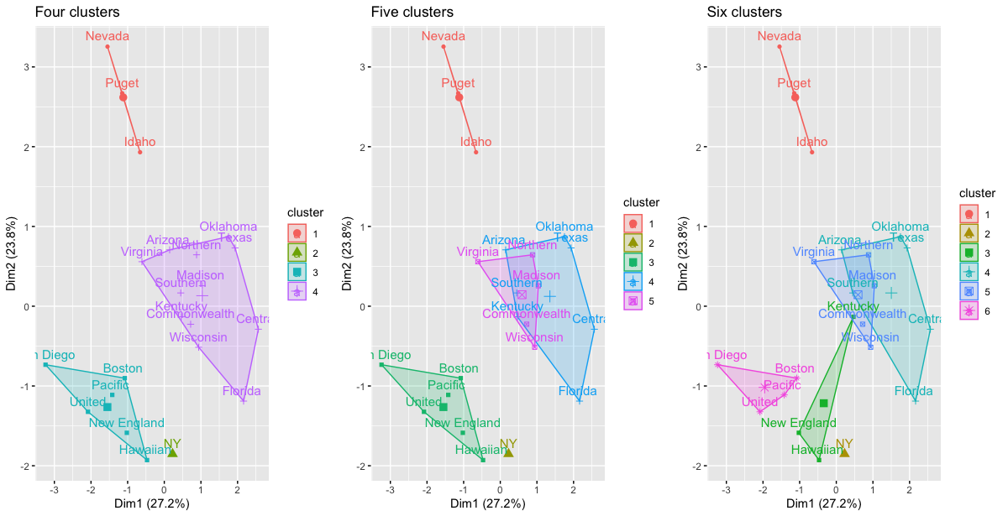
Utility Firms Plots

Slide 32
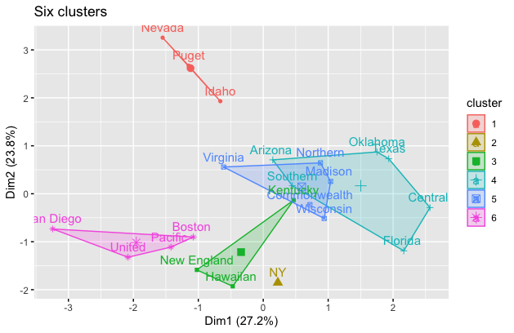
Cluster Characteristics
Centroids = each cluster has a vector of variable means.
Custer 1 has normalized average demand growth of 0.99
> km6.ut$centers
Fixed_charge RoR Cost Load_factor Demand_growth Sales Nuclear Fuel_Cost
1 -0.600 -0.83 1.34 -0.48 0.99 1.86 -0.71 -0.97
2 2.037 -0.86 0.58 -1.30 -0.72 -1.58 0.21 1.69
3 0.628 0.58 0.13 1.42 0.36 -0.43 -0.71 0.66
4 0.384 0.74 -1.15 -0.52 -0.78 0.43 -0.49 -0.41
5 -0.011 0.33 0.22 -0.36 0.17 -0.40 1.57 -0.60
6 -1.093 -1.12 0.20 0.85 0.13 -0.83 -0.20 1.16
Look at Profile Plot.
The magnitude of within-cluster distance
> km6.ut$withinss
[1] 9.5 0.0 6.0 19.4 10.2 12.6
> km6.ut$size
[1] 3 1 3 6 5 4
number of utility firms in each cluster
> dist(km6.ut$centers)
1 2 3 4 5
2 5.557
3 4.104 4.011
4 3.896 4.226 2.960
5 3.753 3.983 3.236 2.844
6 4.012 4.042 2.628 3.782 3.332
Closest clusters

Slide 33
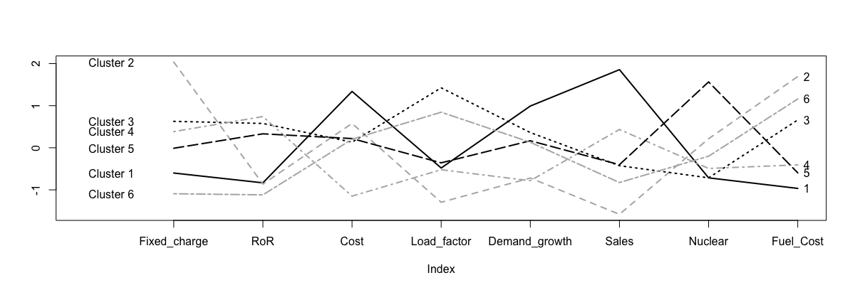
Visualize Cluster Centroids with Profile Plot
# plot an empty scatter plot
plot(c(0), xaxt = 'n', ylab = "", type = "l",
ylim = c(min(km6.ut$centers), max(km6.ut$centers)), xlim = c(0, 8))
# label x-axes
axis(1, at = c(1:8), labels = names(utilities.df))
# plot centroids
for (i in c(1:6)){
lines(km6.ut$centers[i,], lty = i, lwd = 2, col = ifelse(i %in% c(1, 3, 5),
"black", "gray70"))
}
# name clusters
text(x = 0.3, y = km6.ut$centers[, 1], labels = paste("Cluster", c(1:6)))
text(x = 8.1, y = km6.ut$centers[, 8], labels = paste(c(1:6)))

Slide 34
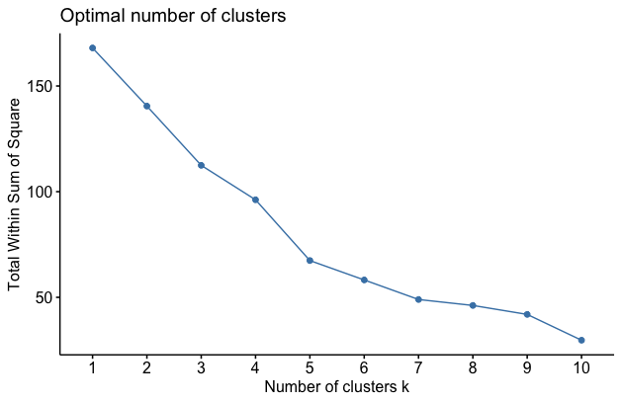
Different Choices for K
As the number of clusters increases, the cluster members are closer to one another.
Question: What happens to the distance between clusters?
Elbow Method
Minimizes total within-cluster sum of square distances

Slide 35
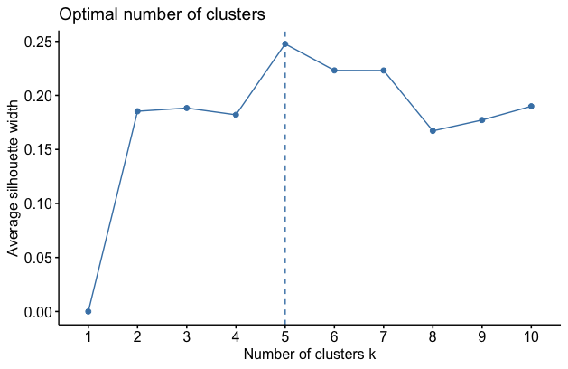
Different Choices for K
Average Silhouette Method
Measures the quality of a clustering.
The method determines how well each object lies within its cluster.
A high average silhouette width indicates good clustering.

Slide 36
Summary
Cluster analysis is an exploratory tool. Useful only when it produces meaningful clusters
Hierarchical clustering gives visual representation of different levels of clustering
On other hand, due to non-iterative nature, it can be unstable, can vary highly depending on settings, and is computationally expensive
Non-hierarchical is computationally cheap and more stable; requires user to set k

